Slide 1


Welcome to Reception
Please sign in next to your child’s name
Please ensure all
phones are on silent

Slide 2
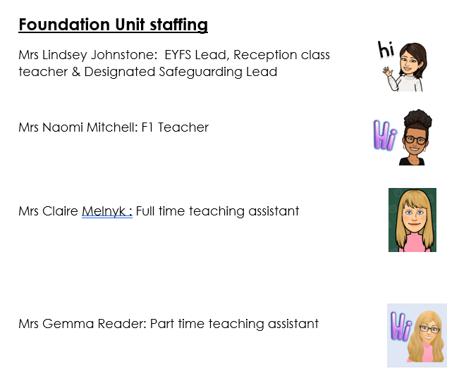

Slide 3


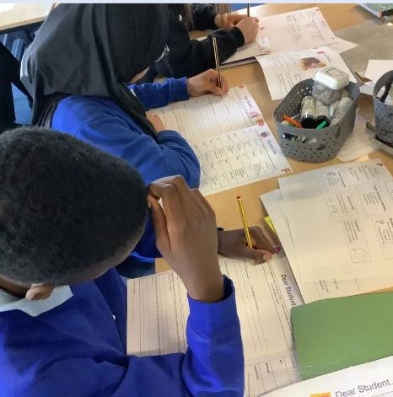
Morning drop Off – the school gate opens at 8.40am
Classroom doors open at a
quarter to nine - 8:45am
School gate closes at 8:55am
Learning time!

Slide 4


Home time collection – the school gate opens at 3.10 pm
The school day ends at 3:15pm
School gates close at 3:20pm
Children must be collected from their classroom door

Slide 5
Punctuality – Every Minute Counts!
Lost minutes = Lost learning
19 days lost
13 days lost
Registers close at 9:00am, after which, your child will be signed in as late.
If your child arrives late and misses learning at the start of the school day your child will quickly fall behind.
10 days lost
6.5 days lost
3 days lost
5 mins late
10 mins late
15 mins late
20 mins late
30 mins late

Slide 6
Attendance Expectations
Attendance | Description | Approximate Days Lost Per Year | Approximate Weeks Lost Per Year
99-100% | Excellent | 0-4 days | Less than 1 week
97-99% | Expected | 5-9 days | 1-2 weeks
96% | Less than expected | 10-13 days | 2-3 weeks
90-95% | Unsatisfactory | 14-18 days | 3-4 weeks
Below 90% | Persistent absence | More than 19 days | More than 4 weeks

Slide 7

Attendance Expectations
5 Consecutive days of term time leave
Term time holidays will not be authorised – fines will be issued £160 per parent per child
10/10 sessions
10 sessions of unauthorised absence in a 10 – week period – penalty notice will be considered

Slide 8

Miss School miss out

Slide 9
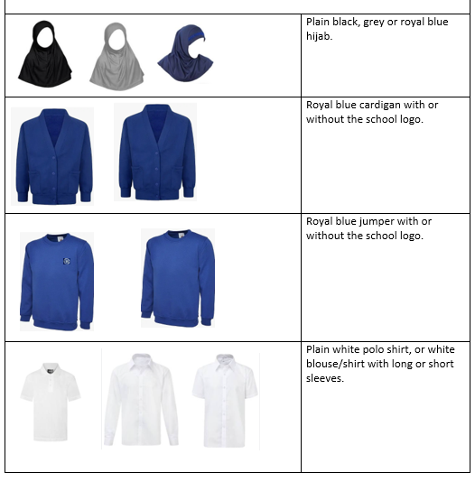
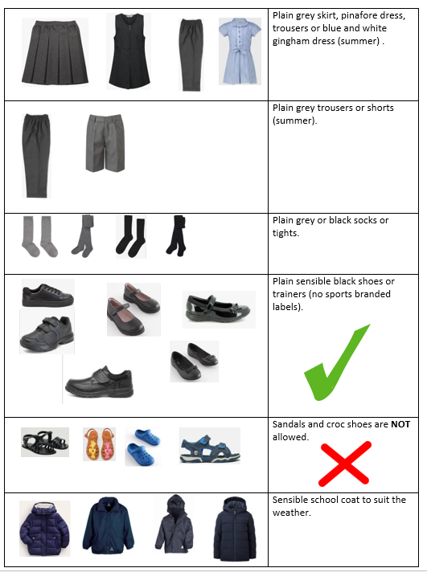
School Uniform

Slide 10
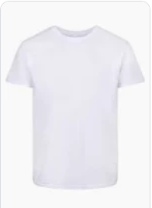
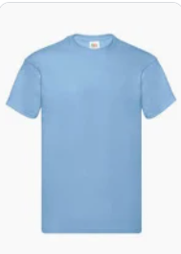
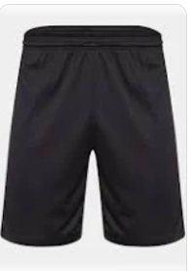
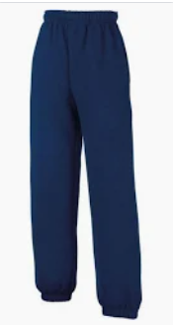
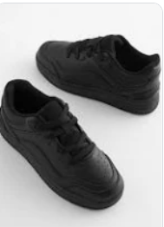
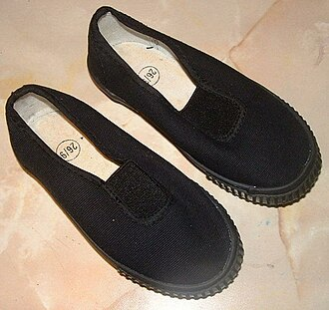
PE day & expectations
A plain white or blue t-shirt
Blue or black shorts, leggings or joggers
Plain blue sweatshirt
Plain black trainers or plimsoles
PE kits must be brought to school in a labelled bag – stay in school for the half term.
Children will change in school.

Slide 11
OUR LEARNING IN EARLY YEARS
Personal , social & emotional development​
​
Communication and Language​
​
Physical development​
​
Literacy​
​
Mathematics​
​
Understanding the World​
​
Expressive art and design

Slide 12
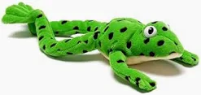



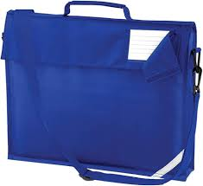

Early Reading and Phonics
Read together every day
Share stories in any language
Talk about books
Return reading book and reading bag daily
Notes:
Reading is one of the most important skills children learn in Reception.
Children will take part in a daily phonics lesson using our Read Write Inc. programme- this teaches sounds not the names of letters e.g. mmmmm not em.
Phonics helps children learn the sounds that letters make and how these sounds blend together to read words.
Once children are ready, they will bring home reading books matched to the sounds they know.
They will also visit our library and choose books to share with you at home.
If English is not your first language, please continue reading and telling stories in your home language too.
Children who enjoy books in any language are developing important reading skills
Many of us can remember stories from our childhood because stories are incredibly powerful - ⭐ Reading for 10 minutes every day has a huge impact on children's progress.

Slide 13

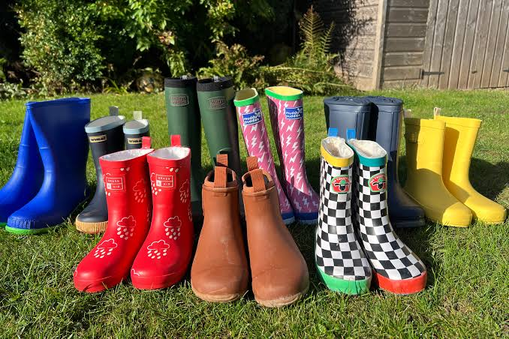
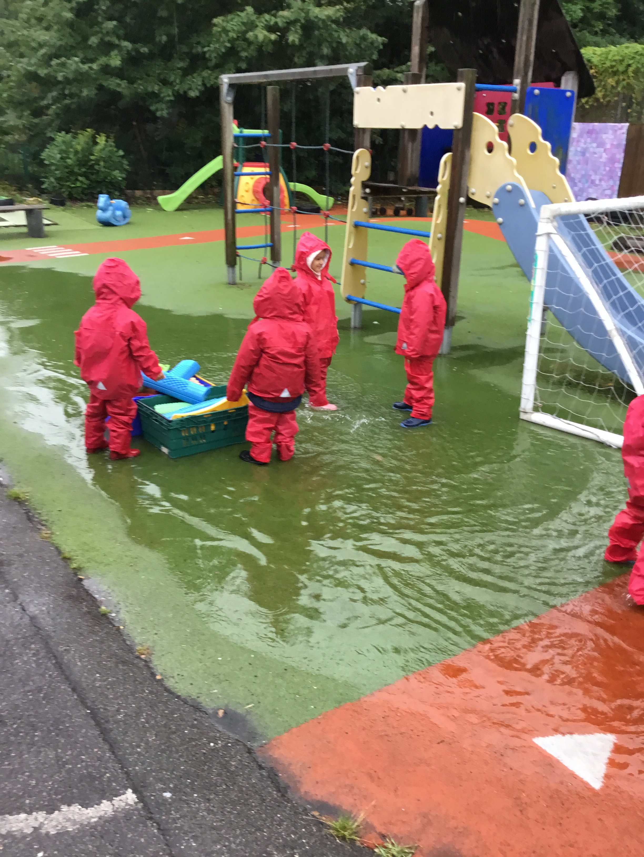
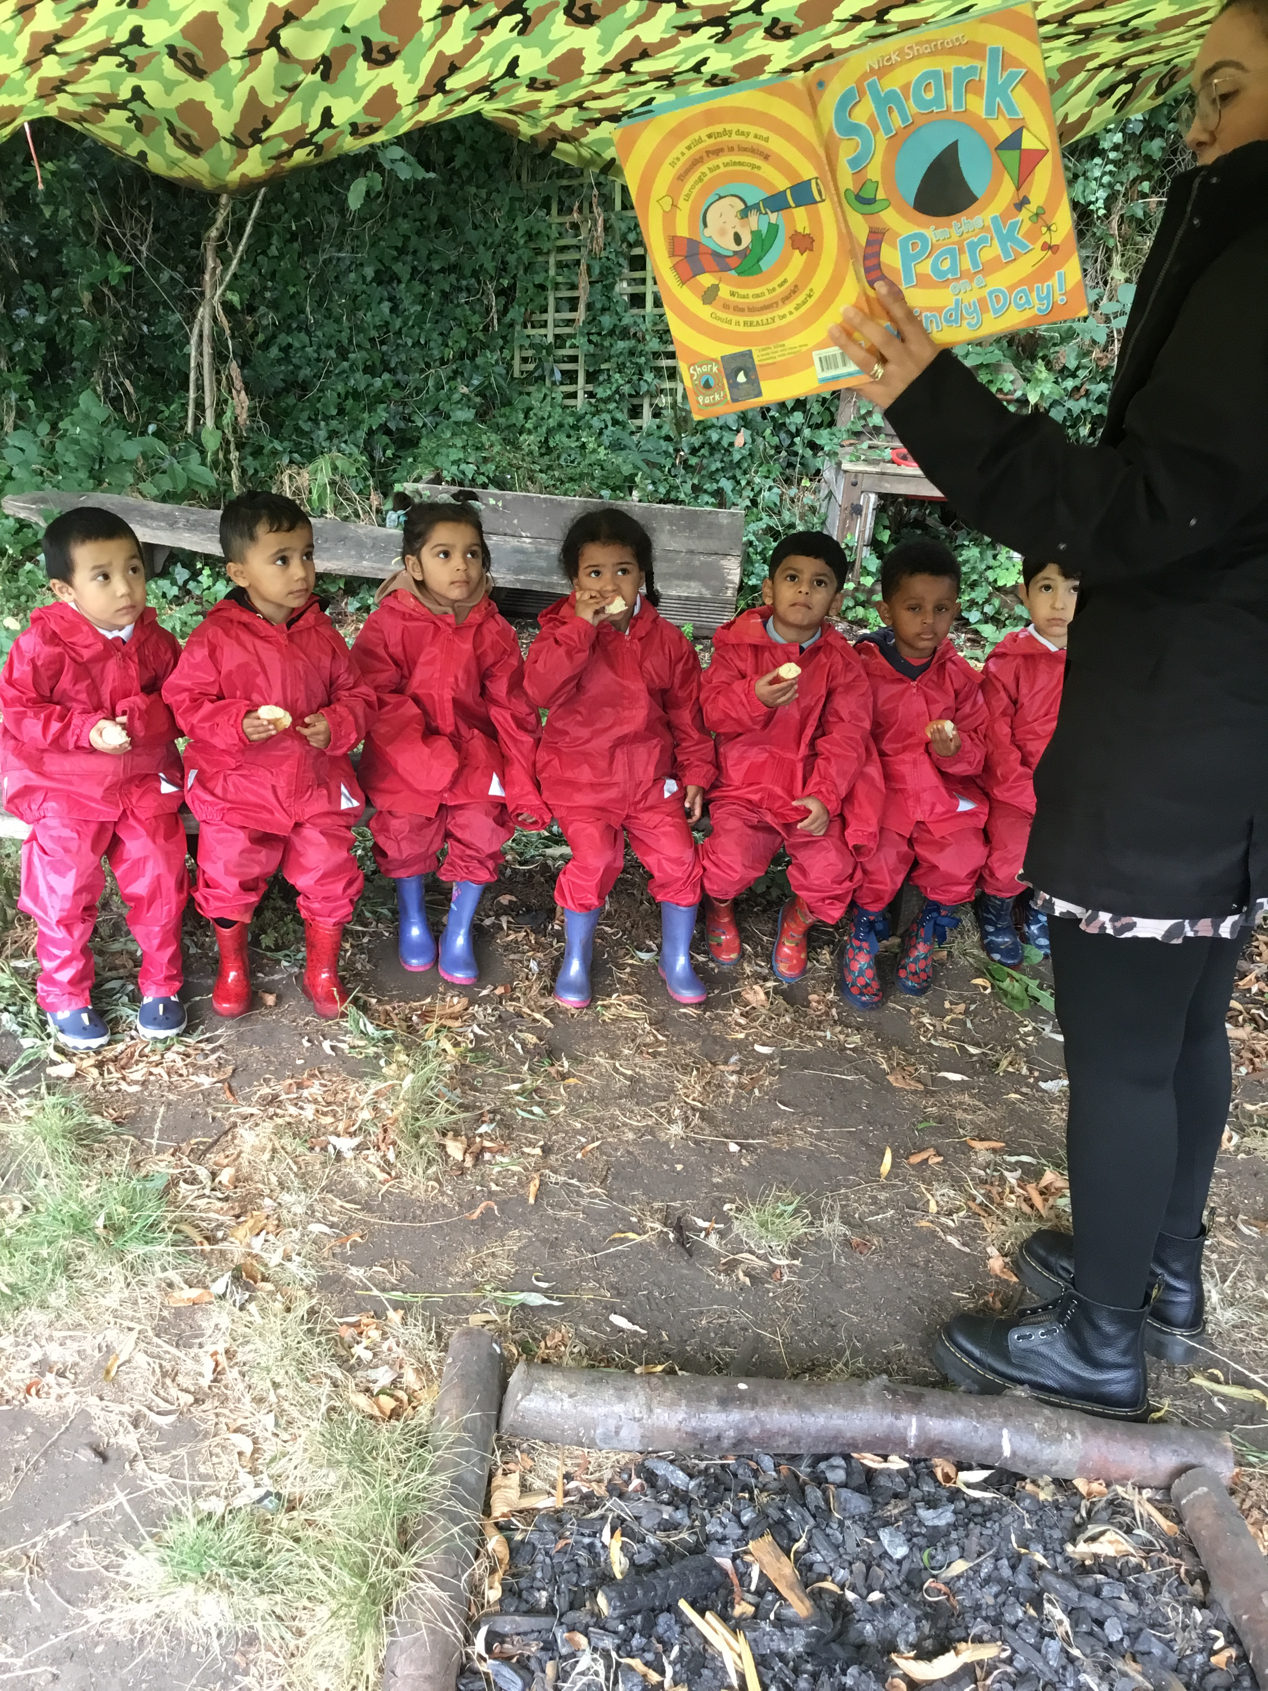
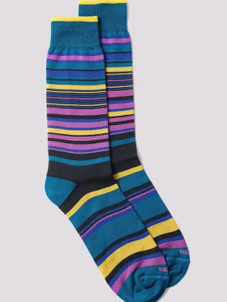
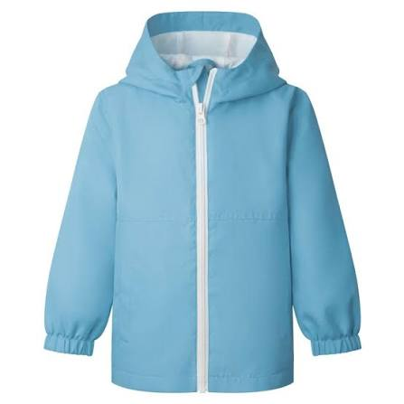
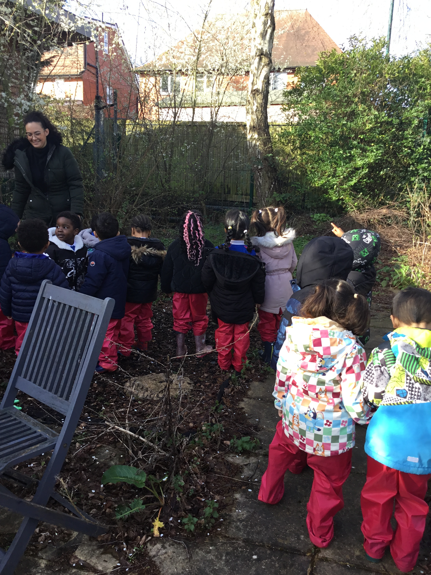
OPAL play
Notes:
One of the things that makes Reception special is how much learning takes place outdoors.
As a school, we use an approach called OPAL (Outdoor Play and Learning). This means children have lots of opportunities to explore, create, investigate and solve problems outside.
When adults think about outdoor play, they often think of children simply running around. In reality, some of the richest learning happens outdoors. Children develop their communication skills, imagination, teamwork, confidence and independence whilst they are playing.
Whether children are building a den, making a mud kitchen recipe, transporting water, digging for worms or creating an obstacle course, they are learning important skills that support all areas of development.
Because we value outdoor learning so highly, we go outside in most weather conditions. We want children to be able to enjoy these opportunities comfortably, so please make sure your child has a named pair of wellies that can stay in school and a spare pair of socks in their bag.
There is a saying in Early Years: there's no such thing as bad weather, only unsuitable clothing! We want every child to be able to join in with every outdoor adventure.
Some of our best learning days are the muddiest ones!
That usually gets a smile from parents and makes the wellies message memorable. It also fits well with the warm, parent-friendly style used throughout the rest of your presentation

Slide 14

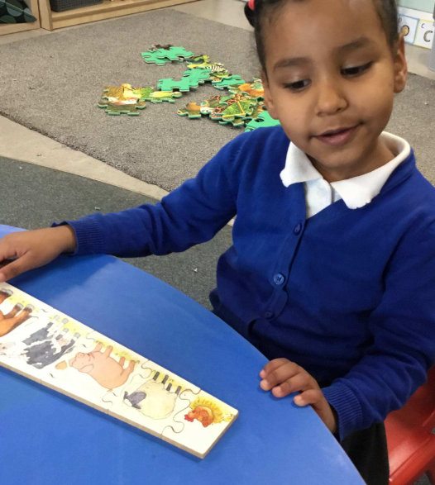
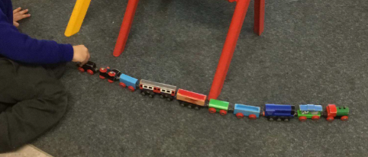
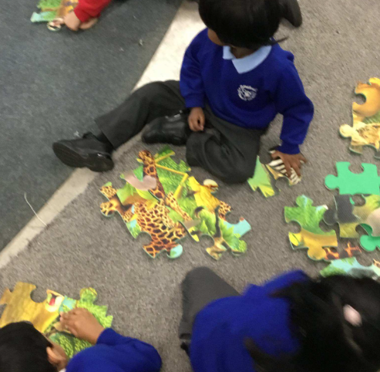

Mathematics in Reception
Counting
Problem Solving
Patterns
Comparing
Practical activities
Sorting
Notes:
Maths in Reception is much more than counting to 10.
Children learn maths through practical experiences, songs, games, stories and play.
We use White Rose Maths to help children develop a deep understanding of number.
We want children to understand what numbers mean, not just recite them.
How do you know there are five apples without counting one-at-a-time?
Parents usually start explaining.
Then say:
This is exactly the kind of mathematical thinking we develop in Reception.
You can support maths at home by:
Counting stairs
Counting plates at dinner
Matching socks
Sharing fruit
Spotting numbers when out and about
Some of the best maths happens in every day activities

Slide 15
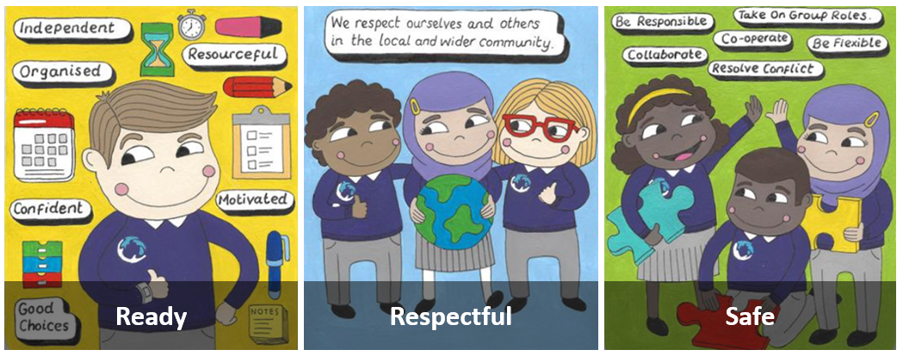
Behaviour
The behaviour culture at Southwold is that:
Being ready for learning is important, individually, and as a group.
We are respectful to others in the local and wider community.
Everyone in the school should be kept safe.
We use responsibility and self-management to be Ready, Respectful and Safe.

Slide 16

Relentless Routines
Awesome Appearance
Marvellous Manners
Wonderful Walking
Legendary Lining Up
Silent Signals
Magnet Eyes/ Cinema Seats

Slide 17
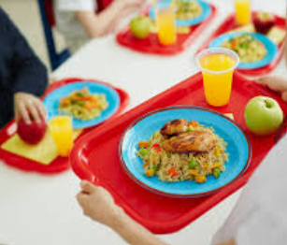


Important Information
PE will be on a Monday. Children will get changed at school. Please make sure they have the correct PE kit. Any earrings must be removed.
Please check Class Dojo regularly for any updates or messages.
Please inform us if your child is having a school dinner or packed lunch.
Please let us know if anybody different is collecting your child.

Slide 18
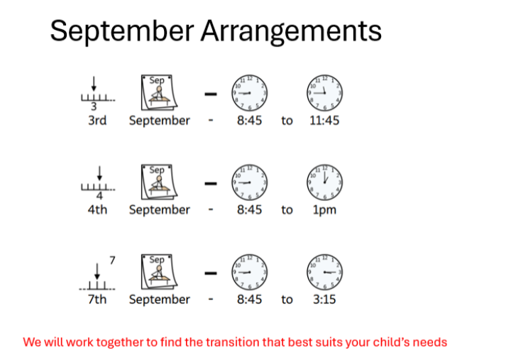

Slide 19

Thank you for coming. We look forward to working with you in September.

