Slide 1


Welcome to Year 6
Mr McArthur, Mrs Laud & Mr Kingham
Please sign in next to your child’s name
Please ensure all
phones are on silent

Slide 2


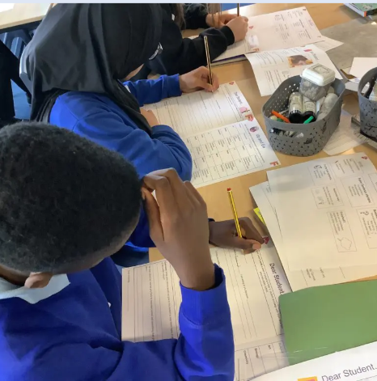
Morning drop Off – the school gate opens at 8.40am
Classroom doors open at a
quarter to nine - 8:45am
School gate closes at 8:55am
Learning time!

Slide 3


Home time collection – the school gate opens at 3.10 pm
The school day ends at 3:15pm
School gates close at 3:20pm
Children must be collected from their classroom door

Slide 4
Punctuality – Every Minute Counts!
Lost minutes = Lost learning
19 days lost
13 days lost
Registers close at 9:00am, after which, your child will be signed in as late.
If your child arrives late and misses learning at the start of the school day your child will quickly fall behind.
10 days lost
6.5 days lost
3 days lost
5 mins late
10 mins late
15 mins late
20 mins late
30 mins late

Slide 5
Attendance Expectations
Attendance | Description | Approximate Days Lost Per Year | Approximate Weeks Lost Per Year
99-100% | Excellent | 0-4 days | Less than 1 week
97-99% | Expected | 5-9 days | 1-2 weeks
96% | Less than expected | 10-13 days | 2-3 weeks
90-95% | Unsatisfactory | 14-18 days | 3-4 weeks
Below 90% | Persistent absence | More than 19 days | More than 4 weeks

Slide 6

Attendance Expectations
5 Consecutive days of term time leave
Term time holidays will not be authorised – fines will be issued £160 per parent per child
10/10 sessions
10 sessions of unauthorised absence in a 10 – week period – penalty notice will be considered

Slide 7

Miss School miss out

Slide 8
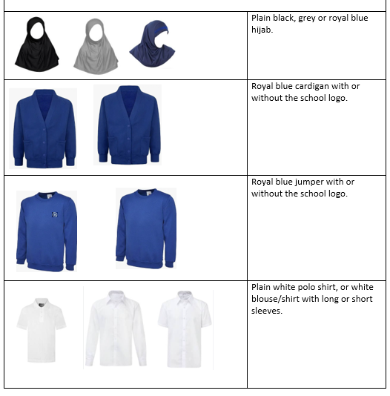
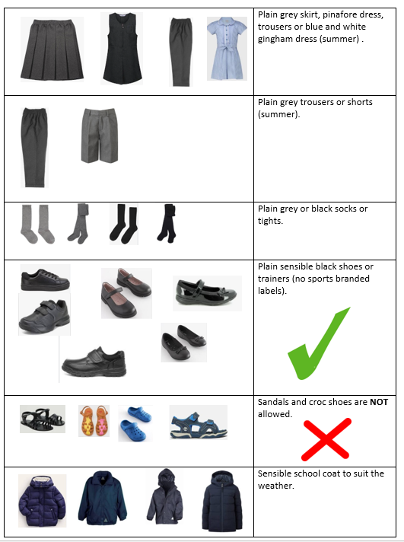
School Uniform

Slide 9
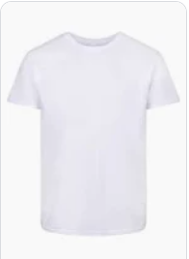

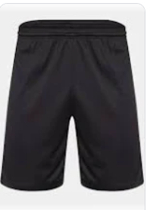

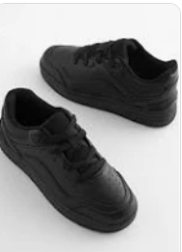
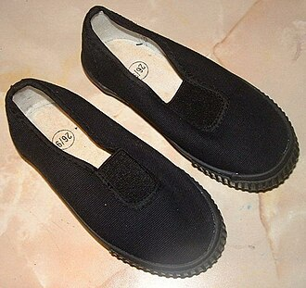
PE day & expectations
A plain white or blue t-shirt
Blue or black shorts, leggings or joggers
Plain blue sweatshirt
Plain black trainers or plimsoles
PE kits must be brought to school in a labelled bag – stay in school for the half term.
Children will change in school.

Slide 10

Behaviour
The behaviour culture at Southwold is that:
Being ready for learning is important, individually, and as a group.
We are respectful to others in the local and wider community.
Everyone in the school should be kept safe.
We use responsibility and self-management to be Ready, Respectful and Safe.

Slide 11

Relentless Routines
Awesome Appearance
Marvellous Manners
Wonderful Walking
Legendary Lining Up
Silent Signals
Magnet Eyes/ Cinema Seats

Slide 12
Weekly timetable
Library visit is on a Friday.
PE is on Tuesday.
Endeavour Assembly is alternate Fridays.
Our Forest School sessions will be in the first term.

Slide 13
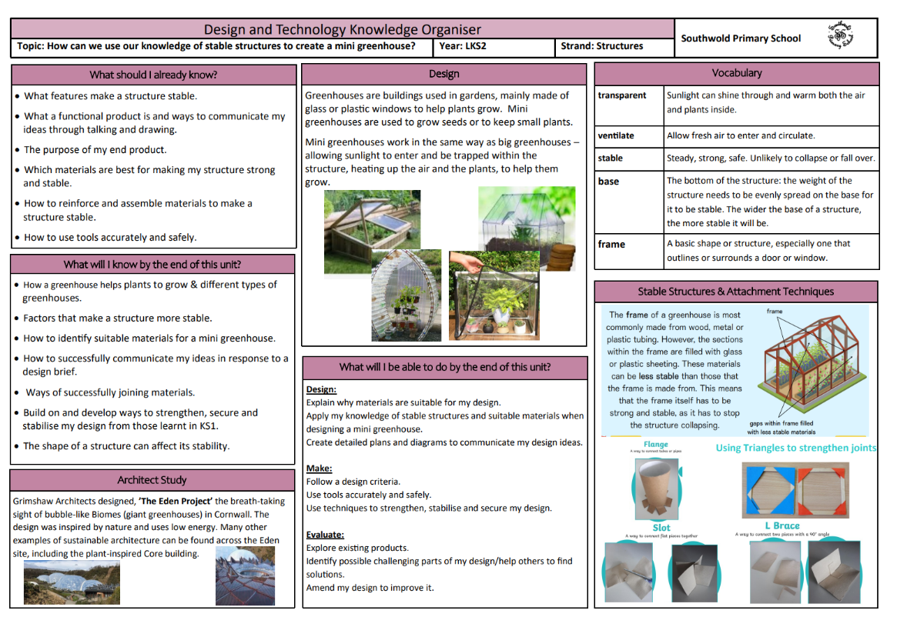
what you need to know:
Knowledge organisers
Sent home to help you see what your child is learning in each subject
Include key learning objectives and important vocabulary
Designed to be shared with your child at home
Help you stay involved in their learning and understand what they’re doing in class

Slide 14
Reading
Your child will take home their reading diary and book every day.
We ask that you listen to your child read 5 times a week.
Your child will visit the school library each week. Please look after these books and return on their library visit day.
Please send your child with a book bag or small rucksack – our cloakroom area is very compact.
Each week we will send a link to an e-book you can share with your child on Oxford Owl.

Slide 15


Maths &
Learning by Questions (LbQ)
Your child will have weekly maths homework and this may look different in each year group.
Over the year, we will develop the use of Learning by Questions (LbQ) which is an online learning platform.
Maths Madness challenges will continue. This will change every half-term. Complete and mark at home for the teacher to check.
It is important to practise your times tables 3-5 times a week, even just for 15 minutes each time.

Slide 16
KS2 SATS – MONDAY 11TH TO THURSDAY 14TH MAY
Monday 11th May:
Punctuation & Grammar
Spellings
Tuesday 12th May:
Reading
Wednesday 13th May:
Arithmetic
Reasoning
Thursday 14th May:
Reasoning 2
Children need a scaled score of 100 to be at expected standard and 110 to be at greater depth.

Slide 17
KS2 SATS Preparation
Assessment weeks in October, December & March
SATs Revision Guides from September
SATs Club – Thursdays (letter in September)
Learning by Questions (LbQ) – weekly tasks
Classroom opening at 08:40 then 08:30
Interventions from September
Tutoring from Spring

Slide 18
SECONDARY SCHOOL
Application Deadline = Friday 31st October 2025.
Offer Day = Monday 2nd March 2026.
Transition events from April 2026.
Y7 Transition Days usually first Tuesday & Wednesday in July.
School Open Evenings usually in September.
Applications are open now.

Slide 19
Into University
Y6 Tudor Focus Week
Monday 15th September to Friday 19th September (second week back)
Walking to the Vine Centre – Monday, Tuesday & Thursday
Fully funded trip to Battle of Bosworth site - Wednesday
Graduation at Jubilee Campus, Nottingham University – Friday
Please take a letter & permission slip & return ASAP!

Slide 20
WALESBY RESIDENTIAL
Wednesday 10th June 2026 to Friday 12th June 2026.
Full payment of £120 is required by Friday 8th May 2026.
A non-refundable £10 deposit by Friday 17th October 2025.
Letter & Arbour payments from September 2025.
All children need a sleeping bag.
Parents Meeting to be held in the summer term regarding kit list.

