Slide 1


Welcome to Reception
Please sign in next to your child’s name
Please ensure all
phones are on silent

Slide 2





Meet the Team
Mrs L. Johnstone: Reception class teacher & EYFS Lead
Mrs N. Mitchell: F1 Teacher
Mrs C. Melynk: EYFS Teaching Assistant
Miss S. Benton: EYFS Teaching Assistant (PT)
Mrs H. Bukhari: EYFS Teaching Assistant (PT)

Slide 3


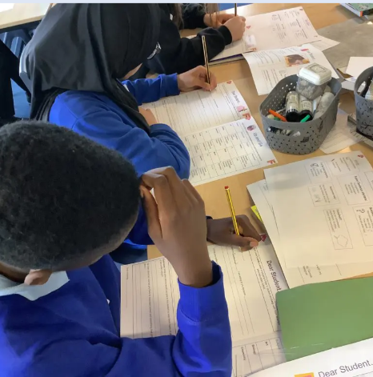
Morning drop Off – the school gate opens at 8.40am
Classroom doors open at a
quarter to nine - 8:45am
School gate closes at 8:55am
Learning time!

Slide 4


Home time collection – the school gate opens at 3.10 pm
The school day ends at 3:15pm
School gates close at 3:20pm
Children must be collected from their classroom door

Slide 5
Punctuality – Every Minute Counts!
Lost minutes = Lost learning
19 days lost
13 days lost
Registers close at 9:00am, after which, your child will be signed in as late.
If your child arrives late and misses learning at the start of the school day your child will quickly fall behind.
10 days lost
6.5 days lost
3 days lost
5 mins late
10 mins late
15 mins late
20 mins late
30 mins late

Slide 6
Attendance Expectations
Attendance | Description | Approximate Days Lost Per Year | Approximate Weeks Lost Per Year
99-100% | Excellent | 0-4 days | Less than 1 week
97-99% | Expected | 5-9 days | 1-2 weeks
96% | Less than expected | 10-13 days | 2-3 weeks
90-95% | Unsatisfactory | 14-18 days | 3-4 weeks
Below 90% | Persistent absence | More than 19 days | More than 4 weeks

Slide 7

Attendance Expectations
5 Consecutive days of term time leave
Term time holidays will not be authorised – fines will be issued £160 per parent per child
10/10 sessions
10 sessions of unauthorised absence in a 10 – week period – penalty notice will be considered

Slide 8

Miss School miss out

Slide 9
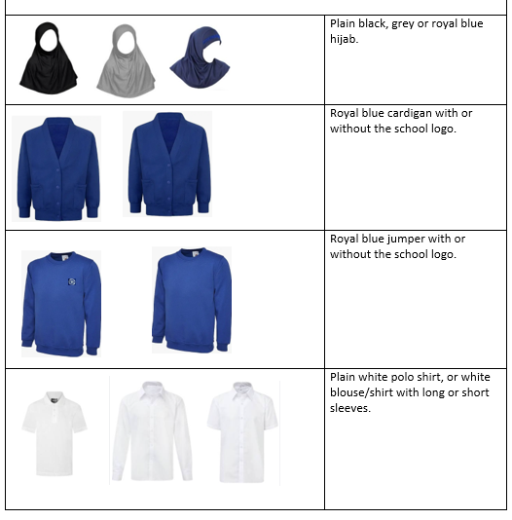
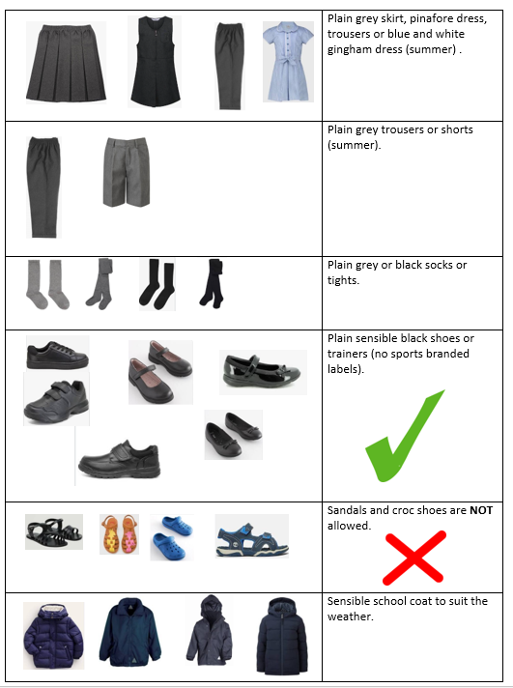
School Uniform

Slide 10


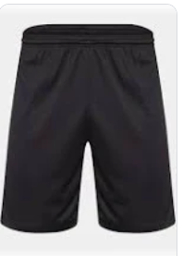

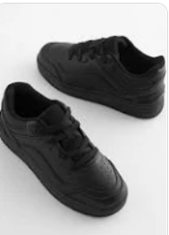
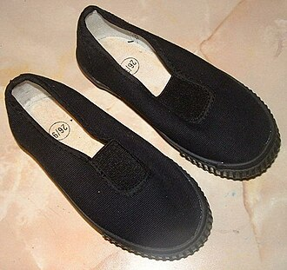
PE day & expectations
A plain white or blue t-shirt
Blue or black shorts, leggings or joggers
Plain blue sweatshirt
Plain black trainers or plimsoles
PE kits must be brought to school in a labelled bag – stay in school for the half term.
Children will change in school.

Slide 11
OUR LEARNING IN EARLY YEARS
Personal , social & emotional development​
​
Communication and Language​
​
Physical development​
​
Literacy​
​
Mathematics​
​
Understanding the World​
​
Expressive art and design

Slide 12

Early Reading
Phonics is taught using Read Write Inc.​
​
All children will have a daily phonics lesson.​
​
When children begin to learn sounds they will come home with a reading book.​
​
All children will go to the school library and bring home a book. ​
​
Please read 5 times weekly at home.
Please send reading bag to school every day.

Slide 13

Maths
Maths is taught in short sessions using White Rose Maths.
Children will have 4 maths session a week.

Slide 14

Behaviour
The behaviour culture at Southwold is that:
Being ready for learning is important, individually, and as a group.
We are respectful to others in the local and wider community.
Everyone in the school should be kept safe.
We use responsibility and self-management to be Ready, Respectful and Safe.

Slide 15

Relentless Routines
Awesome Appearance
Marvellous Manners
Wonderful Walking
Legendary Lining Up
Silent Signals
Magnet Eyes/ Cinema Seats

Slide 16
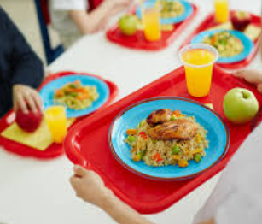


Important Information
PE will be on a Tuesday. Children will get changed at school. Please make sure they have the correct PE kit. Any earrings must be removed.
Please check Class Dojo regularly for any updates or messages.
Please inform us if your child is having a school dinner or packed lunch.
Please let us know if anybody different is collecting your child.

Slide 17
September Arrangements
Week Beginning 8th September: All children will attend school 8.45-11.45
Week Beginning 15th September: All children will attend school from 8.45-1. Children will stay for lunch.
Week Beginning 22nd September: All children will begin full time.
Notes:
Staggered start to settle children
Only reception children will be here to settle. Nursery will be in pm

Slide 18

Thank you for coming. We look forward to working with you in September.

